Slide 1

Barter Database
N
Phase I Presentation
Team Leads:
Nikhitha Kilari
Lalith Aditya chunduri

Slide 2


ABSTRACT OF THE PROJECT:
A
z
Online platform for secure and anonymous trading and selling.
Users can trade without knowing each other's identities.
Secure and encrypted transactions using hashing of achieved trades.
No direct contact required between users.
Trades conducted via a credit system.
Backend development focuses on secure trade management and user interaction.
Reliable and secure dialogue between users.
Strong emphasis on privacy and anonymity.
User-friendly interface for ease of use.
Admin dashboard for controlling and managing the barter exchange process.

Slide 3
INTRODUCTION:
A
z
The Barter DB platform allows users to trade goods while maintaining anonymity, which is often lacking on other comparable sites. It features an advertisement board where users can create offers for products they want to acquire and list items they wish to exchange. All transactions are processed through a clearing house using hashed verification, ensuring security for both parties. The platform's design combines the concepts of equality and privacy, with an administrative module to manage user actions and exchanges. The project's goal is to develop a simple yet secure database and online framework that enhances the trading process by ensuring seamless, safe transactions.

Slide 4
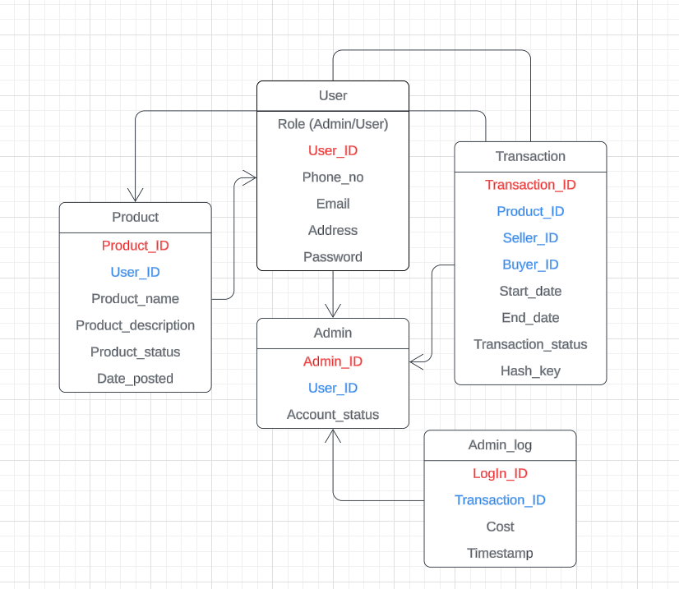
ER DIAGRAM (Entity Relationship Model)
N
z

Slide 5

Tools that Planning on using
N
z
Database: MySQL
Front-End: HTML, CSS, Java Script.
Documentation: Overleaf
ER-Diagram-Lucid Chart
Server: Xampp
Other Cretaive Tools: Microsoft Power BI, Python, GIT Hub etc.

Slide 6
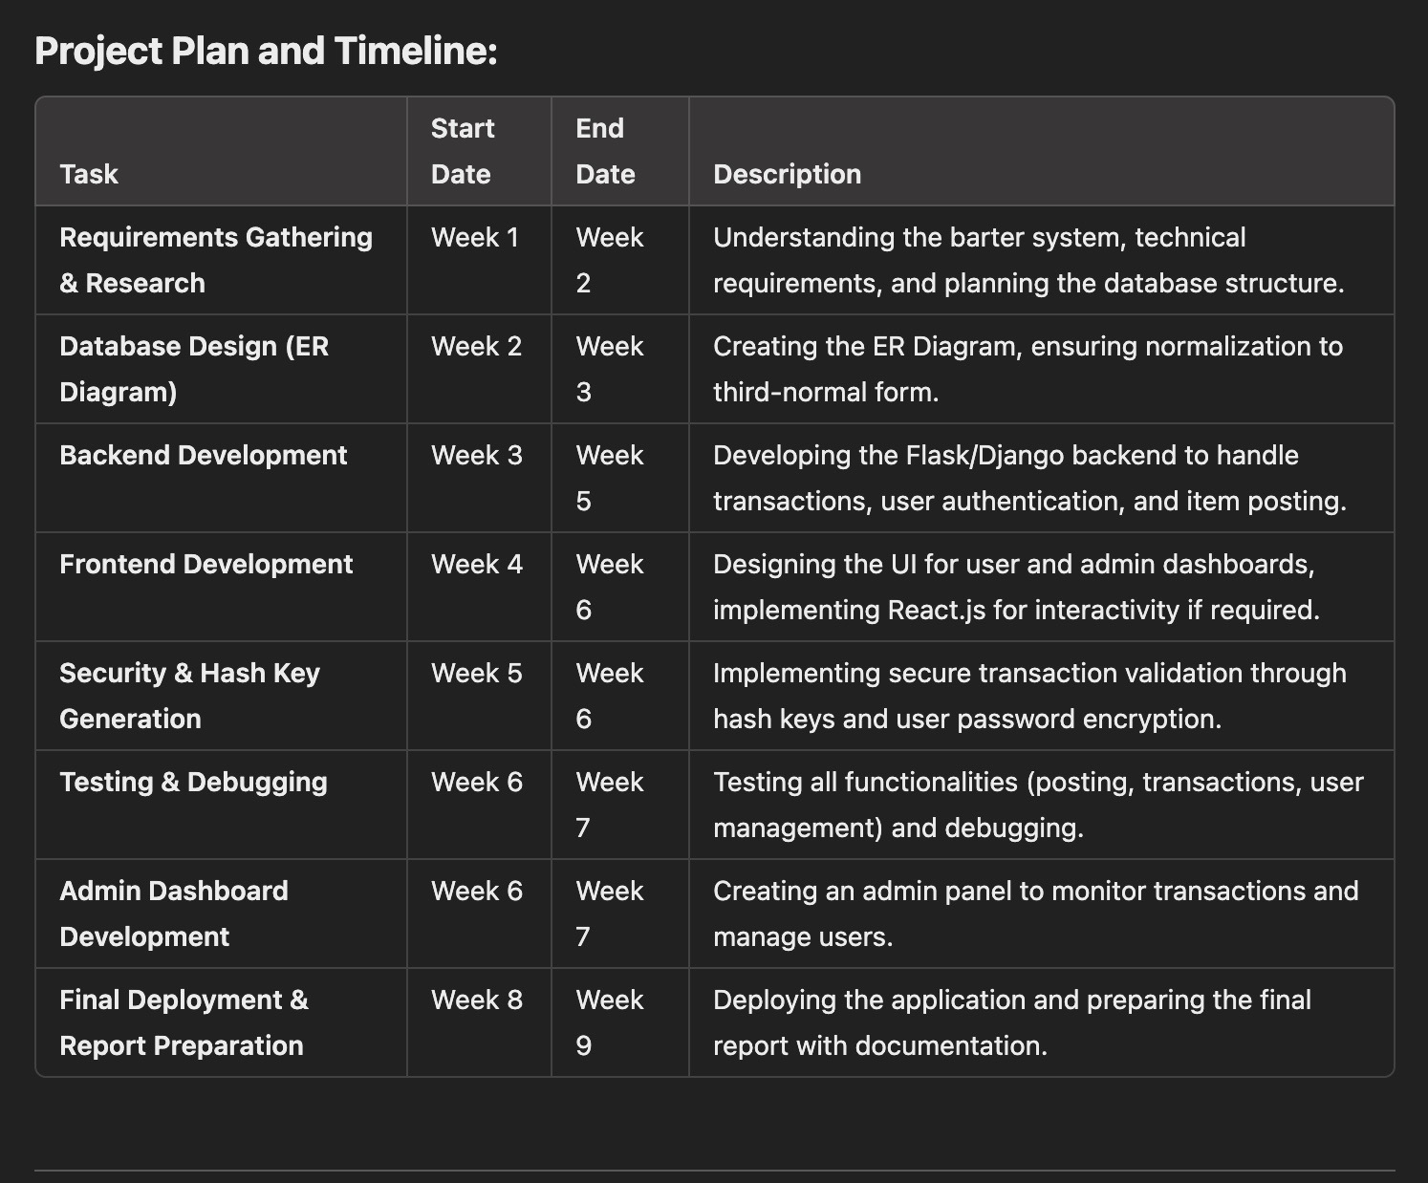
PLAN AND TIMELINE
A

Slide 7
Team members & Role division:
A
z
Nikki - Database Design and User Dashboard
Designing a third-normal form (3NF) database to store data such as products, users, transactions, and hash keys.
Developing a user dashboard that allows users to view products they’ve posted for trade, active transactions, and completed exchanges.
Aditya - Admin Dashboard and Trade Interface
Building the admin dashboard for managing user accounts (approve, suspend, delete) and overseeing transactions.
Creating the interface that enables valid users to post items for trade and request exchanges.

Slide 8
Project Expectations and Aspirations
N
Secure Trading Platform
-Use hashed data and encrypted transactions to protect user anonymity
User-Friendly Interface
-Design intuitive dashboards for smooth product postings and trade management
Scalability and Flexibility
-Build a system capable of handling multiple users and divers trade types efficiently
Learning and Collaboration
-Apply course concepts to real-world challenges, enhancing our skills in database design and security
z

Slide 9

Conclusion of the Project
N
z
By developing a safe, decentralized platform which operates on contemporary security norms, BarterDB seeks to offer a solution against the challenges of anonymous trading. Giving an all-embracing bartering system where transaction costs will be kept to the minimum and security enhanced. User requirements will be satisfied with BarterDB’s powerful backend, easy to use front end, and good admin dashboard. The main objective of this project will not only be the practical realization of the technologies of the database and security but also the provision of a perspective for further development of the system.

Slide 10

Thank you
Any Questions?

